Slide 1
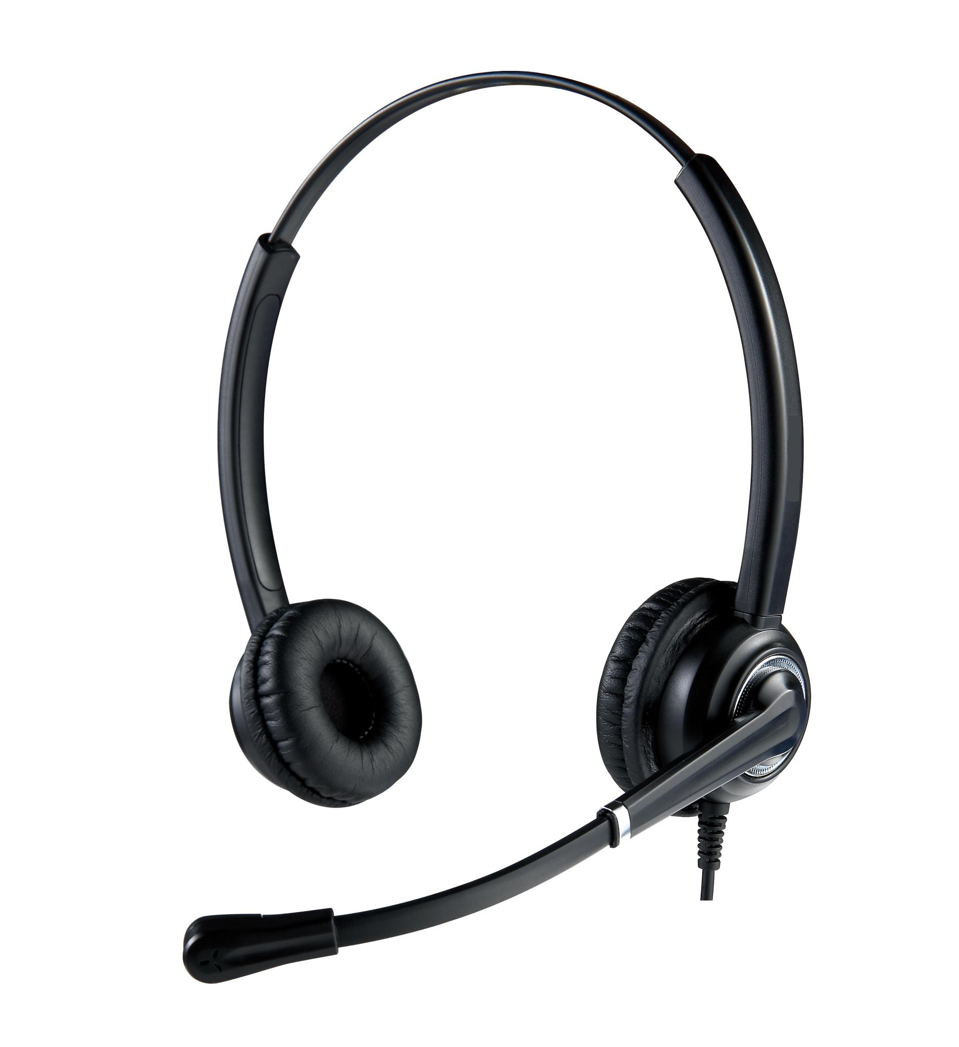
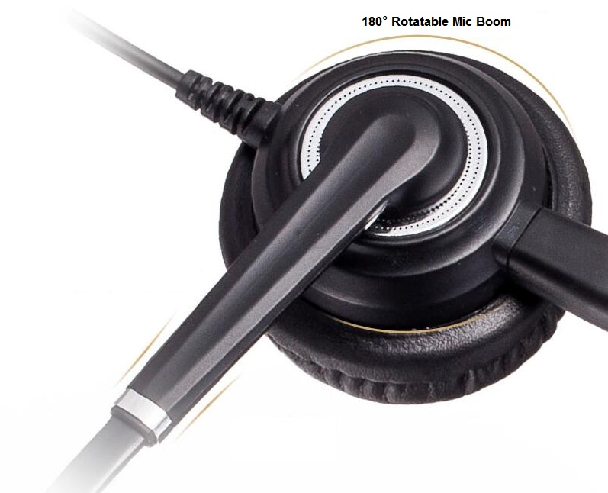
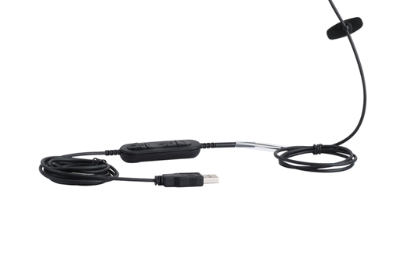

Unified Communication Headset
612UC
Introduction
Fashionable metallic design with great durability and reliability
Bendable microphone arm for flexible and precise positioning
Wideband speakers provide clear sound quality
Noise-canceling microphone for clearer calls, improving communication quality
Big ear pad and plush soft protein leather ear cushion ensures whole-day wearing comfort
Robust and ergonomic design for all-day comfort
Structrue Features
Super light weight design
Superb receiver audio quality
Outstanding noise cancellation
330°rotatable microphone arm
180°rotatable joint of speaker and headband
60mm adjustable pliable steel headband

Slide 2
FEATURE | BENEFIT
Flexible Connectivity | Plug and Play USB connecting for PC
Hi-Fi audio speakers – Frequency range up to 10 KHz | Superior call clarity and music performance
Extra noise-canceling microphone | Effectively reduces surrounding noises, ensures superior sound clarity even in noisy office environments.
Anti-Static shock protection | Protects users’ hearing health
Professional and stylish design | Durable and light weight design for all day wearing, attractive appearance meets all user’s favor
Large and soft ear cushions | Cancel background noise effectively and make superior comfort
Convenient inline call-control function | Intuitive call-control unit with quick access to answer/end call, mute and volume controls
Compatible with Skype , Skype for Business,Lync and other unified communication systems, plug and play | Simply connect headset to computer and it is ready for use
Flexible microphone boom | Ensures optimal microphone positioning for noise-reduction
330°rotatable microphone arm | Rotating microphone boom arm in both directions supports left and right wearing style
Optimized for leading UC platforms | Compatible with the latest generation of soft phones
Two years warranty | Enjoy worry-free ownership

Slide 3
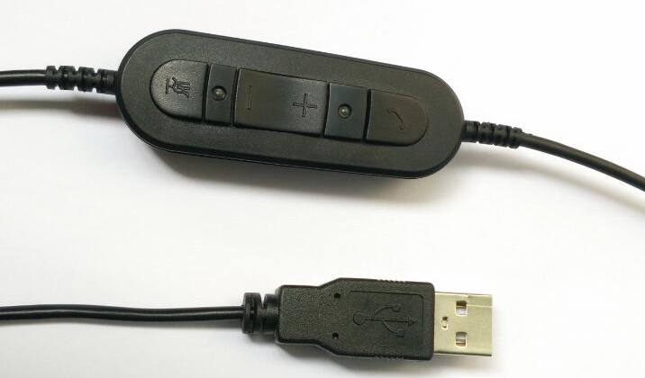
Headset Set Up
2
Connect the USB adaptor into any USB port on the computer.
This headset is plug and play, does not require software installation.
1
3
User Guide
① In-line microphone mute: press the mute button to activate mute , press again to de-activate mute.
② Microphone mute LED indicator(red)
③ In-line speaker volume controller: press “+” to increase speaker volume, press“-” to decrease speaker volume
④ In-line hook for answer/end call: press the button to answer the call , press again to end the call
⑤ Hook LED indicator( green)
5
4
Note
*The in-line hook is specially designed for Skype,Skype for Business and Lync, it may not be available for other systems.
* You are required to install "Skypeheadset” software on your PC if you want to use HOOK function on Skype.
* Pls contact with your supplier to get the "Skypeheadset" installation file.

